Slide 1
Project Presentation on
“Depression detection using Voice”
Marathwada Mitra Mandal’s College of Engineering,Karvenagar, Pune-52
Department of Information Technology
By
Group - 11
Under the Guidance of
Prof. Pratik Kamble.

Slide 2
INTRODUCTION
What is depression?
Depression is a common mood disorder.
Characterized by sadness, loss of interest, feelings of guilt or low self-worth and poor concentration.
Long-lasting or recurrent.
Significant impact on individuals,their families and on society.

Slide 3
Solution
We propose a system which records patient`s voice through the Android application.
Through NLP we can detect depression to help doctor in diagnosis of patient.

Slide 4
Objective
The objective is to provide:
Convenient methods that assist doctors in their diagnosis of depression.
Depression is a severe mental health disorder with high societal costs.Thus to provide good service to patients and all lives in society.

Slide 5
Software requirements : 1)Java Android
2)MySQL, SqLite
Hardware requirements: 1)RAM 4GB
2)HD 500GB
Communication/Protocol required: Internet, Http

Slide 6
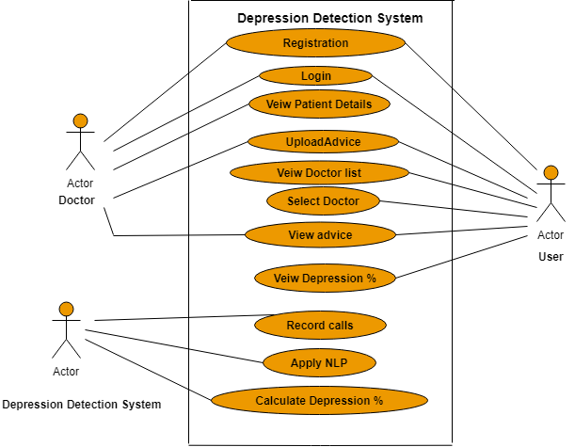
Use case Diagram

Slide 7
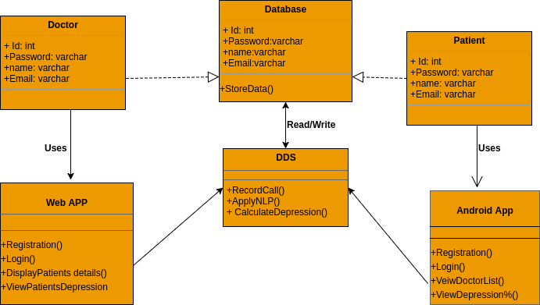
Class Diagram

Slide 8
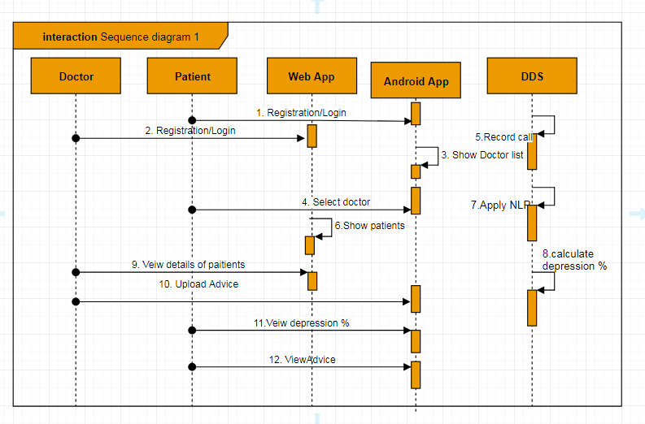
Sequence Diagram

Slide 9
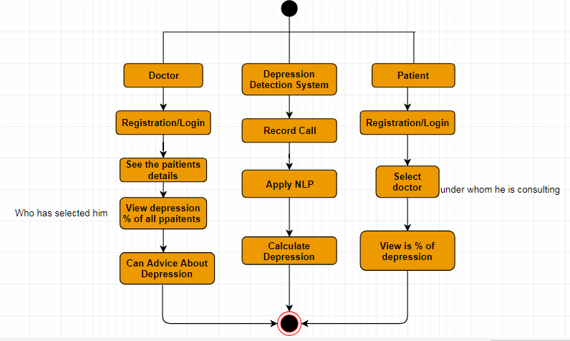
Activity Diagram

Slide 10
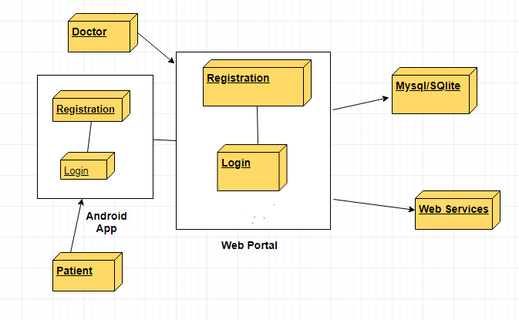
Deployment Diagram

Slide 11
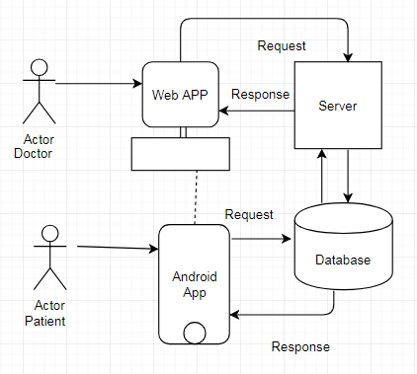
Architectural Diagram

Slide 12
Applications
We are building a doctor patient android application.
Mental health monitoring.
There are two modules:
Patient Module:It is going to be the client.
Doctor Module: It will diagnose that there are any depression symptoms or not.

Slide 13
THANK YOU!!!

Slide 14
SlidesCarnival icons are editable shapes.
This means that you can:
Resize them without losing quality.
Change line color, width and style.
Isn’t that nice? :)
Examples:

Slide 15
😉
Now you can use any emoji as an icon!
And of course it resizes without losing quality and you can change the color.
How? Follow Google instructions https://twitter.com/googledocs/status/730087240156643328
✋👆👉👍👤👦👧👨👩👪💃🏃💑❤😂😉😋😒😭👶😸🐟🍒🍔💣📌📖🔨🎃🎈🎨🏈🏰🌏🔌🔑 and many more...

